Slide 1
30/03/2022
Title: Factorising
Aim:
Be able to factorise expressions.
Plan:
Daily review
Substitution and evaluation.
The factorisation process.
Independent practice.

Slide 2
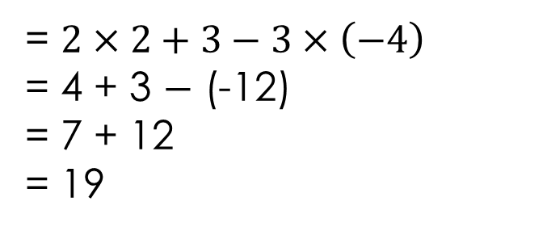
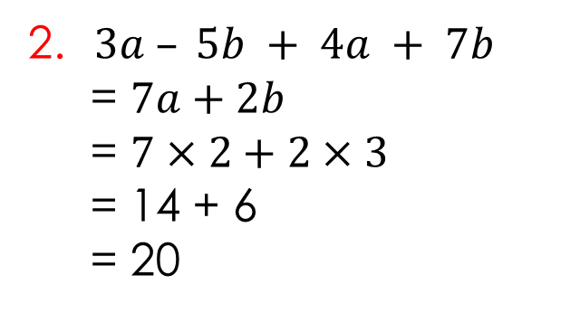
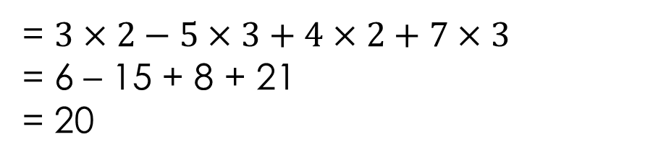


Daily review: Substitution
Evaluate the following expressions if $a=2, b=3 and c=−4$
1. $2a+b−3c$
= $2×2+3−3×\left(−4\right)$
= 4 + 3 $−$ (-12)
= 7 + 12
= 19
2. $3a – 5b + 4a + 7b$
2. $3a – 5b + 4a + 7b$
= $7a+2b$
= $7×2+2×3$
= 14 + 6
= 20
= $3×2−5×3+4×2+7×3$
= 6 – 15 + 8 + 21
= 20

Slide 3
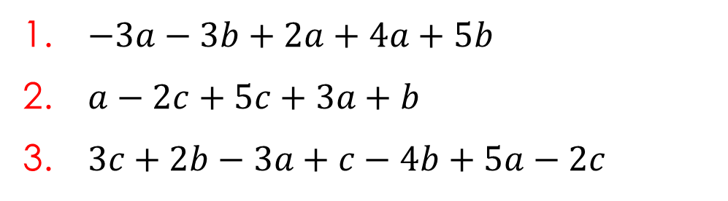
Exercise books
Evaluate the following expressions if $a=2, b=3 and c=−4$
$−3a−3b+2a+4a+5b$
$a−2c+5c+3a+b$
$3c+2b−3a+c−4b+5a−2c$

Slide 4
The factorisation process
Look for highest common factor (HCF).
Write terms as a product of factors using HCF.
Take highest common factor to front of brackets.

Slide 5
What is a factor?
https://www.youtube.com/watch?v=0NvLtTwnUHs
(Stop after 1:20)
Factorising expressions requires us to identify the Highest/greatest common factor (HCF).
https://www.youtube.com/watch?v=crWLFqOQtBA
(can stop after 4min)

Slide 6
Finding highest common factor (HCF)
List all factors of each term
e.g.,
18x + 14
Factors of 18x
1, 2, 3, 6, 9, 18, x
Factors of 14
1, 2, 7, 14
2 is the HCF of 18x and 14

Slide 7
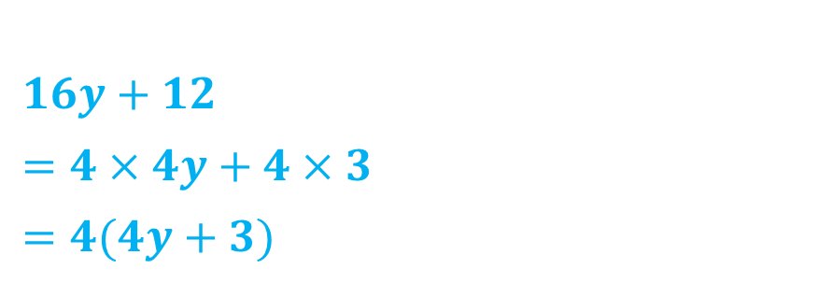
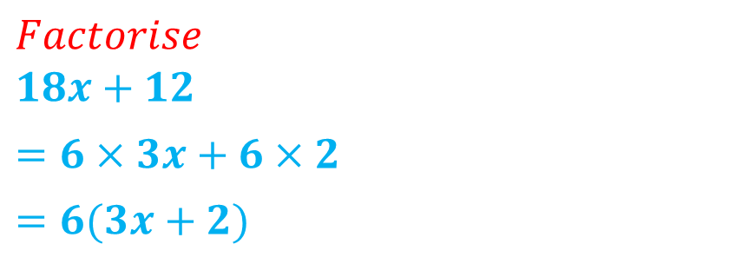
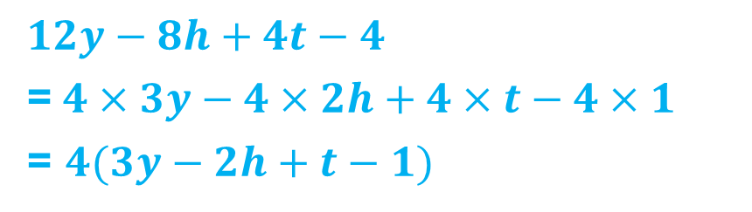
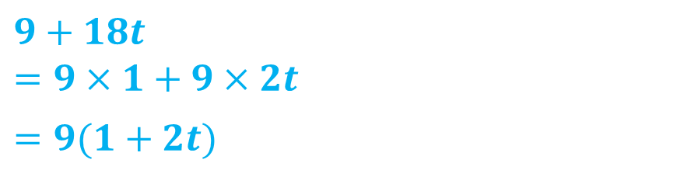
Exercise books
Look for highest common factor
Write terms as a product of factors using HCF
Take highest common factor to front of brackets.
$Factorise$
$18x+12$
$=6×3x+6×2$
$=6(3x+2)$
HCF = 6
$9+18t$
$=9×1+9×2t$
$=9(1+2t)$
HCF = 9
$16y+12$
$=4×4y+4×3$
$=4(4y+3)$
HCF = 4
$12y−8h+4t−4$
=$4×3y−4×2h+4×t−4×1$
= $4(3y−2h+t−1)$
HCF = 4

Slide 8
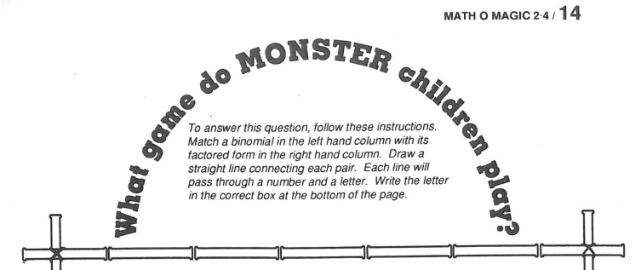

Write answers on the sheet

Slide 9
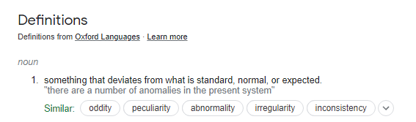

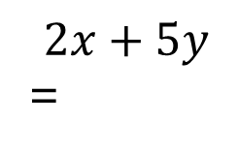
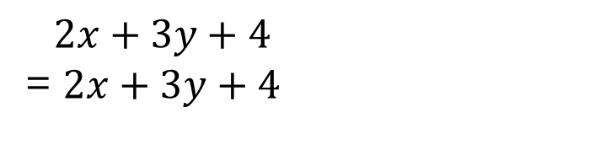
Simplify $2x+3y+4$
$2x+3y+4$
= $2x+3y+4$
Factorise $2x+5y$
$$2x+5y$$
=
CBF (Can’t be factorised)

Slide 10
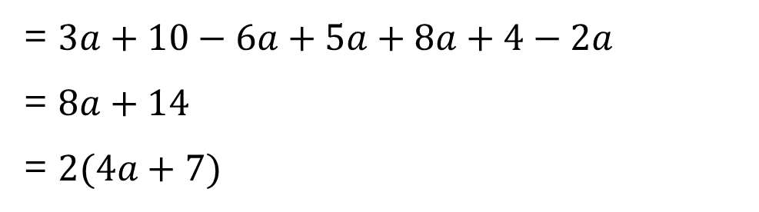
Challenge question
Simplify and then factorise the following expression.
$$3a+2\left(5−3a\right)+5a+4\left(2a+1\right)−2a$$
= $3a+10−6a+5a+8a+4−2a$
= $8a+14$
= $2(4a+7)$

